Slide 1
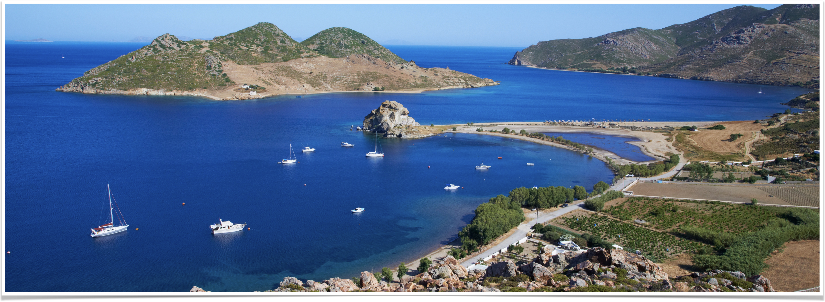
The Revelation of Jesus Christ
Vision 3, Part 4 (Revelation 13:5-12) - The Two Beasts

Slide 2
Summary of 13:3-4, 17:11-13
The successive invasions by Germanic tribes seem to deal a death blow to Rome.
But the Latin church revived the empire and becomes the eighth phase of Roman power.
The kingdoms of Europe that rose out of the Roman Empire eventually acquiesced to the authority of the Roman church
This alliance of church and state creates a beast unlike any other; it is revered by mankind and cannot be defeated by human means
Notes:
The successive invasions by Germanic tribes seem to deal a death blow to Rome.
But the Latin church revived the empire and becomes the eighth phase of Roman power.
The kingdoms of Europe that rose out of the Roman Empire eventually acquiesced to the authority of the Roman church
This alliance of church and state creates a beast unlike any other; it is revered by mankind and cannot be defeated by human means

Slide 3
Quick review of the beast
5 heads = 5 phases of Roman power have passed
6th head: the Caesars from Augustus (27 BC) to Aurelian (282 AD)
7th head: from Diocletian/Constantine to the fall of Rome in 476
  Beast seems to be dead, but lives on
Beast itself is the eighth: the Roman Church (priests, bishops, archbishops, cardinals, councils, church bureaucracy)
10 horns = European powers that rose out of Rome’s fall
Notes:
5 heads = 5 phases of Roman power have passed
6th head: the Caesars from Augustus (27 BC) to Aurelian (282 AD)
7th head: from Diocletian/Constantine to the fall of Rome in 476
Beast seems to be dead, but lives on
Beast itself is the eighth: ecclesiastical hierarchy of the Roman Church (priests, bishops, archbishops, cardinals, popes)
10 horns = European powers that rose out of Rome’s fall

Slide 4
13:5-7: An enemy of God and His people
“And he was given a mouth speaking great things and blasphemies, and he was given authority to continue for forty-two months. [6] Then he opened his mouth in blasphemy against God, to blaspheme His name, His tabernacle, and those who dwell in heaven. [7] It was granted to him to make war with the saints and to overcome them. And authority was given him over every tribe, tongue, and nation.”
Notes:
Revelation 13:5-7, “And he was given a mouth speaking great things and blasphemies, and he was given authority to continue for forty-two months. [6] Then he opened his mouth in blasphemy against God, to blaspheme His name, His tabernacle, and those who dwell in heaven. [7] It was granted to him to make war with the saints and to overcome them. And authority was given him over every tribe, tongue, and nation.”

Slide 5
The beast is given four things
Verse 5: he is “given a mouth”
Verse 5: he is “given authority” over “every tribe, tongue, and nation” (verse 7)
Verse 5: he is given “forty-two months”
Verse 5: he is given authority “to make war with the saints and to overcome them”
Notes:
Verse 5: he is “given a mouth”
Human means of communication; opened his mouth.
Blasphemy – to speak with the intent to injure or harm; to insult God or anything associated with God.
Verse 5: he is “given authority” over “every tribe, tongue, and nation” (verse 7)
Satan gives the beast his authority
Verse 5: he is given “forty-two months”
Time, times, and 1/2 a time
1,260 days
3.5 years
Verse 5: he is given authority “to make war with the saints and to overcome them”

Slide 6
The beast blasphemes…
God - more about this when we get to the second beast in verse 11
His tabernacle - the church
  Church is typically referred to as a temple — Ephesians 2:21, 1 Peter 2:4-5
  Hebrews 8-9 - the tabernacle foreshadows the church (Hebrews 11:9-10, 13-16)
  Church = tabernacle in Revelation because it is in the wilderness (12:14)
Those in heaven - ???
Notes:
God - more about this when we get to the second beast in verse 11
His tabernacle - the church
Church is typically referred to as a temple — Ephesians 2:21, 1 Peter 2:4-5
Hebrews 8-9 - the tabernacle foreshadows the church (Hebrews 11:9-10, 13-16)
Tabernacle is a temporary dwelling place
Looking for a permanent home, the city which has foundations whose builder and maker is God (chapters 21-22)
Church = tabernacle in Revelation because it is in the wilderness (12:14)
Those in heaven - ???

Slide 7
The beast blasphemes those in heaven

Slide 8
The cult of the martyrs
Develops in the second and third centuries
Those who remained faithful became local heroes
Burial sites became places of prayer
Grassroots — started at local churches
Notes:
Develops in the second and third centuries
Those who remained faithful became local heroes
Burial sites became places of prayer
The graves of Peter and Paul are known in Rome and become sacred sites to the local Christian community
Peter is purportedly buried on Vatican Hill, not one of the “seven hills of Rome” but an eighth hill across the Tiber River
Grassroots — started at local churches

Slide 9
Gains speed in the fourth century
Deaths celebrated annually
Calendars of martyrs’ deaths compiled
Shrines and church built near or over graves
Relics believed to have miraculous powers
Records of lives recorded and heavily embellished
Belief developed that martyrs could intercede with God
Notes:
When Constantine embraced Christianity and began transitioning Rome to a Christian empire, these heroes of Christianity grew in notoriety.
The martyrs’ deaths were celebrated annually with speeches, parades, and feasts.
Calendars of martyrs’ deaths were compiled and local heroes became famous in broader Christendom.
Shrines and churches were built near or over the graves of the martyr and believers fervently desired to be buried near the tomb of a martyr.
Constantine built the first St. Peter’s basilica on Vatican Hill
The relics of martyrs – everything from an object they possessed to scraps of clothing they wore to body parts – were believed to have miraculous powers.
Records of the lives of the martyrs were recorded and heavily embellished to the point of being unbelievable and unserious.
But most concerning was the growing belief that martyrs could intercede with God on behalf of the living – folks were encouraged to pray to these deceased heroes.

Slide 10
“... the bishops saw it necessary to evaluate and legitimize these cults. In doing so, the bishop would inquire into the circumstances of the purported martyr's death and, finding it ideologically sound, would send the martyr's name and an account of their passing to neighboring churches so that, in event of approval by their respective bishops, the cults of the martyr might also extend to their churches.”
–From the New World Encyclopedia
Notes:
Remember: this begins as a grassroots effort
Beast = ecclesiastical hierarchy (bishops)
Bishops begin determining who is and is not a true martyr
The bishops should have been correcting this false doctrine; now they were endorsing and promoting it

Slide 11
Morphs into the cult of the saints
Branches out to include venerable monks and bishops toward the end of the fourth century
Bishops were inconsistent — some poor candidates were canonized
“By the 10th century, appeals were made to the pope. The first saint canonized by a pope was Ulrich, bishop of Augsburg, who died in 973 and was canonized by Pope John XV at a synod held in the Lateran in 993. Pope Alexander III (1159–81) began to reserve the cases of canonization to the Holy See, and this became general law under Pope Gregory IX (1227–41)” (Encyclopedia Brittanica).
Notes:
Toward the end of the fourth century, the cult of martyrs began to branch out to include venerable monks and bishops whose sacrifices and service to the church were equivalent to martyrdom.
This development signaled the transition from the cult of the martyrs to the cult of the saints.
Because the authority to declare the deceased a saint lay in the hands of local bishops, the standards to achieve that status were not uniform and, therefore, inconsistent.
“By the 10th century, appeals were made to the pope. The first saint canonized by a pope was Ulrich, bishop of Augsburg, who died in 973 and was canonized by Pope John XV at a synod held in the Lateran in 993. Pope Alexander III (1159–81) began to reserve the cases of canonization to the Holy See, and this became general law under Pope Gregory IX (1227–41).” (https://www.britannica.com/topic/canonization)
The beast (the ecclesiastical hierarchy of the church of Rome) blasphemed those in heaven by creating first the cult of the martyrs and later the cult of the saints.

Slide 12
The beast makes war with the saints

Slide 13
Secular persecution of heretics
The council of Toulouse in 1119 ordered, “that (the heretics who reject the sacraments) be punished by the temporal power.”
The Lateran council of 1139, “condemned heretics to be, 'imprisoned by the Catholic princes,' and their goods confiscated.”
“...in the Lateran council [of 1179] Pope Alexander III again authorized princes to imprison heretics, and again submitted the goods of these men to confiscation.”
Notes:
NOTE: all quotes taken from LaGarde’s History of the Latin Church in the Middle Ages
The council of Toulouse in 1119 ordered, “that (the heretics who reject the sacraments) be punished by the temporal power.” – LaGarde, TLCITMA, p. 496
The Lateran council of 1139, “condemned heretics to be, 'imprisoned by the Catholic princes,' and their goods confiscated.” – LaGarde, TLCITMA, p. 496
“...in the Lateran council [of 1179] Pope Alexander III again authorized princes to imprison heretics, and again submitted the goods of these men to confiscation.” LaGarde, TLCITMA, p. 496

Slide 14
Council of Verona, 1184
“Counts, barons, rectors, and consuls of cities or other places shall be ordered by the bishops to bind themselves by an oath to afford the church, whenever required to, a devoted and efficient cooperation, in all good faith, and according to their means. If they refuse this cooperation, they will be deprived of their places, without compensation, and their lands will be put under an interdict.”
Notes:
At the council of Verona in 1184, Pope Lucius III declares: “Counts, barons, rectors, and consuls of cities or other places shall be ordered by the bishops to bind themselves by an oath to afford the church, whenever required to, a devoted and efficient cooperation, in all good faith, and according to their means. If they refuse this cooperation, they will be deprived of their places, without compensation, and their lads will be put under an interdict.”
Threatened nobles with the loss of status, lands, and wealth
Why would such threats need to be made?

Slide 15
Lateran council, 1215
“The excommunicated prince [for his refusal to intervene against heretics] shall at the end of a year be denounced by the Sovereign Pontiff, who shall free his subjects from their oath of fidelity, and deliver his country to invasion of Catholics.”
Notes:
THIS IS THE FOURTH LATERAN COUNCIL
In the Lateran council of 1215, Innocent III ordered: “The excommunicated prince [for his refusal to intervene against heretics] shall at the end of a year be denounced by the Sovereign Pontiff, who shall free his subjects from their oath of fidelity, and deliver his country to invasion of Catholics.” – LaGarde,TLCITMA, p. 499
NOTE: secular authorities inconsistently followed the orders of the church; so the papacy threatened excommunication for non-compliance

Slide 16
13:8-10:
All who dwell on the earth will worship him, whose names have not been written in the Book of Life of the Lamb slain from the foundation of the world. If anyone has an ear, let him hear. He who leads into captivity shall go into captivity; he who kills with the sword must be killed with the sword. Here is the patience and the faith of the saints.

Slide 17
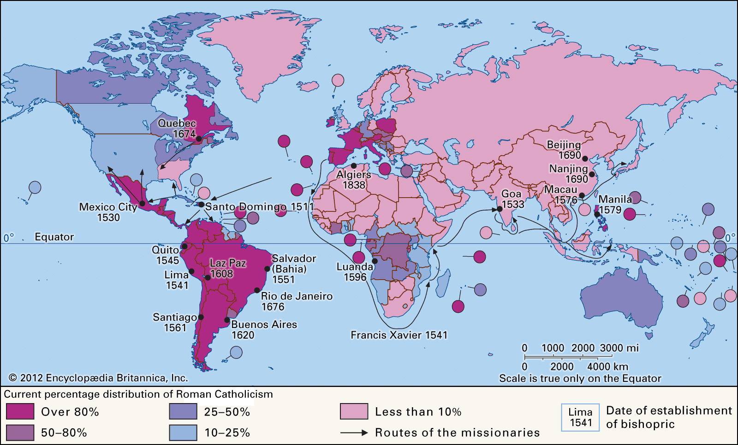
Notes:
Verse 8, “All who dwell on the earth..”
Distribution of the Catholic Church as of 2012
Notice the bishoprics outside of Europe and when many of those were established: within 200 years of the Reformation
Story about Long Vu (keep his name out of it)

Slide 18
The book of life
God’s record of the faithful
First mentioned by Moses in Exodus 32:32
Mentioned again in Daniel 12:1 (other places in between Moses and Daniel)
Luke 10:20, “Nevertheless do not rejoice in this, that the spirits are subject to you, but rather rejoice because your names are written in heaven.”
7 references in Revelation: 3:5, 13:8, 17:8, 20:12 and 15, 21:27, 22:19
Notes:
God’s record of the faithful
First mentioned by Moses in Exodus 32:32
Mentioned again in Daniel 12:1 (other places in between Moses and Daniel)
Luke 10:20, “Nevertheless do not rejoice in this, that the spirits are subject to you, but rather rejoice because your names are written in heaven.”
7 references in Revelation: 3:5, 13:8, 17:8, 20:12 and 15, 21:27, 22:19

Slide 19
The lamb slain
“…from the foundation of the world” - God’s foreordained plan of salvation
1 Peter 1:19-20, “but with the precious blood of Christ, as of a lamb without blemish and without spot. [20] He indeed was foreordained before the foundation of the world, but was manifest in these last times for you,”
2 Timothy 1:9-10, “who has saved us and called us with a holy calling, not according to our works, but according to His own purpose and grace which was given to us in Christ Jesus before time began, [10] but has now been revealed by the appearing of our Savior Jesus Christ, who has abolished death and brought life and immortality to light through the gospel,”
Notes:
“…from the foundation of the world” - God’s foreordained plan of salvation
1 Peter 1:19-20, “but with the precious blood of Christ, as of a lamb without blemish and without spot. [20] He indeed was foreordained before the foundation of the world, but was manifest in these last times for you,”
2 Timothy 1:9-10, “who has saved us and called us with a holy calling, not according to our works, but according to His own purpose and grace which was given to us in Christ Jesus before time began, [10] but has now been revealed by the appearing of our Savior Jesus Christ, who has abolished death and brought life and immortality to light through the gospel,”

Slide 20
If anyone has an ear
Echoes the message to the seven churches of Asia (see chapters 2-3)
The church should be careful
The beast is deceptive
  The world worships the beast as a god
  A second beast is coming to help the first — see verses 13-14
  The faithful can get carried away
An invitation to repent — is anyone listening?
Notes:
Echoes the message to the seven churches of Asia (see chapters 2-3)
The church should be careful
The beast is deceptive
The world worships the beast as a god
A second beast is coming to help the first — see verses 13-14
The faithful can get carried away
An invitation to repent — is anyone listening?

Slide 21
Verse 10
Beast = earthly power antagonistic to God’s people
How have these beasts operated in time past?
  Assyria, Babylon, Persia, Greece, Rome
  God’s people were subjugated, they were not free, they were in captivity
To lead into captivity and be killed with the sword is to be in league with the beast - Galatians 6:7, Matthew 26:52
Notes:
Verse 10, “He who leads into captivity shall go into captivity; he who kills with the sword must be killed with the sword.”
Remember, the beast represents an earthly power antagonistic to the people of God.
How have these “beasts” operated in time past?
Assyria: conquered the northern kingdom of Israel and scattered its citizens all over the Middle East and Meditteranean worlds.
Babylon: conquered Judah and carried it into captivity.
Persia: allowed a small number to return to the homeland to rebuild Jerusalem and the temple; kept the rest scattered.
Greece: some Jews in Palestine, most Jews a part of the Diaspora.
From Assyria to Rome, God’s people were a subjugated nation – they were not free, they were in captivity.
To lead into captivity and to kill with the sword is to be in league with the beast.
If you are in league with the beast, if you worship the beast, you will pay the same consequences as the beast.
Galatians 6:7, “Do not be deceived, God is not mocked; for whatever a man sows, that he will also reap.”
Matthew 26:52 But Jesus said to him, "Put your sword in its place, for all who take the sword will perish by the sword.

Slide 22
“Then a third angel followed them, saying with a loud voice, ‘If anyone worships the beast and his image, and receives his mark on his forehead or on his hand, [10] he himself shall also drink of the wine of the wrath of God, which is poured out full strength into the cup of His indignation. He shall be tormented with fire and brimstone in the presence of the holy angels and in the presence of the Lamb. [11] And the smoke of their torment ascends forever and ever; and they have no rest day or night, who worship the beast and his image, and whoever receives the mark of his name.’”
–Revelation 14:9-11
Notes:
“He who leads into captivity shall go into captivity; he who kills with the sword must be killed with the sword.”
“…his mark on his forehead or on his hand” — a sign of ownership
If you are in league with the beast you will suffer the same punishment as the beast

Slide 23
The patience and faith of the saints
God knows who are His
  Their names are in His book (13:8, 17:8)
  His name is on their forehead; they are sealed (7:3-4, 14:1)
He will reward faithfulness: Revelation 3:5, “He who overcomes shall be clothed in white garments, and I will not blot out his name from the Book of Life; but I will confess his name before My Father and before His angels.”
Notes:
God knows who are His
Their names are in His book (13:8, 17:8)
His name is on their forehead; they are sealed (7:3-4, 14:1)
He will reward faithfulness: Revelation 3:5, “He who overcomes shall be clothed in white garments, and I will not blot out his name from the Book of Life; but I will confess his name before My Father and before His angels.”

Slide 24
13:11-12: The second beast
Then I saw another beast coming up out of the earth, and he had two horns like a lamb and spoke like a dragon. And he exercises all the authority of the first beast in his presence, and causes the earth and those who dwell in it to worship the first beast, whose deadly wound was healed.

Slide 25
Another beast
“…coming up out of the earth” - as opposed to the sea
“…two horns” — two “kingdoms” (remember 17:12)
“…horns like a lamb and spoke like a dragon” - looks like Jesus but talks like Satan
  Matthew 7:15 - wolves in sheep’s clothing
  This is a dragon in lamb’s clothing
Notes:
“…coming up out of the earth” - as opposed to the sea
“…two horns” - two “kingdoms” (remember 17:12)
“The ten horns which you saw are ten kings who have received no kingdom as yet, but they receive authority for one hour as kings with the beast.” (Revelation 17:12)
“…horns like a lamb and spoke like a dragon” - looks like Jesus but talks like Satan
Matthew 7:15 - wolves in sheep’s clothing
This is a dragon in lamb’s clothing

Slide 26
Exercises all the authority…
Given authority for 42 months (verse 5).
Blasphemes God, His name, His tabernacle, the saints, and the angelic host (verse 6).
Makes war with the saints (verse 7)
Given authority over every tribe, tongue, and nation (verse 7)
All who dwell on earth who are not Christians will worship him (verse 8)
Notes:
Given authority for 42 months (verse 5).
Blasphemes God, His name, His tabernacle, the saints, and the angelic host (verse 6).
Makes war with the saints (verse 7)
Given authority over every tribe, tongue, and nation (verse 7)
All who dwell on earth who are not Christians will worship him (verse 8)

Slide 27
Final descriptions…
“And he exercises all the authority of the first beast in his presence…”
  The second beast exists concurrently with the first beast
“…causes the earth and those who dwell in it to worship the first beast, whose deadly wound was healed”
  The second beast is an enforcer, he works together with the first beast

Slide 28
Who is the second beast?
If the first beast is Rome
And the eighth phase of Roman power is the Latin church
Then the second beast is the papacy

Slide 29
Summary of Revelation 13:5-12
The Latin church blasphemed God, His church, and those who were martyred for their faith in Jesus.
Secular authorities were urged by the Latin church to root out heresy — anyone who would not submit to the church’s authority was put to death
The church should take to heart God’s warnings and persevere in the face of these trials
The papacy would work together with the Latin church to accomplish its objectives

